Slide 1
Cost aware resource management in distributed cloud data centers
Master Thesis
Technical University of Vienna
Author: Andreas Egger
MatrNr.: 0626885
Supervisor: Univ. Prof. Dr. Ivona Brandic

Slide 2
Overview
Introduction
Main Contributions
Methodological Approach
Forecasting
Simulation Scenario
Results
Conclusion

Slide 3
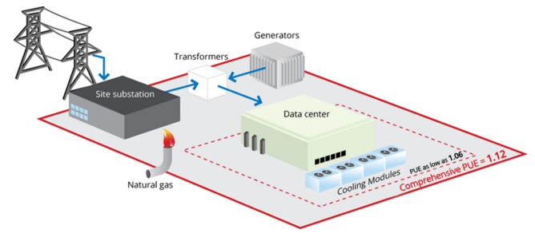
Introduction
Cost optimization in data centers
Improve efficiency
Reduce power consumption
Resource scheduling algorithms
Huge power consumption
1.3% of global electricity use in 2010
198 TWh -> 3 x City of Los Angeles
$9.9B @ 50 $ / MWh
Source: Google Data Center Efficiency [1]
Notes:
Los Angeles Power Consumption 2010 [1]: 68.255 TWh
Population of Los Angeles [2]: 18,550,288
[1] US city power consumption http://ecdms.energy.ca.gov/elecbycounty.aspx
https://www.quora.com/How-much-electricity-does-an-industrialized-city-of-1-million-people-consume
[2] https://en.wikipedia.org/wiki/Demography_of_the_United_States

Slide 4
Introduction
Goals of this thesis
Electricity cost reduction through intelligent resource scheduling
Utilize energy market price volatility to save energy costs
Data analysis of day ahead and real time power markets
Selection of forecasting models to be used for energy price prediction
Simulation of cloud conditions to evaluate cost savings in cloud environments
Definition of a cloud scheduler for handling the trade off between cost reductions and SLA penalties
Provide decision aid for cloud providers for optimal VM migration conditions
Notes:
Los Angeles Power Consumption 2010 [1]: 68.255 TWh
Population of Los Angeles [2]: 18,550,288
[1] US city power consumption http://ecdms.energy.ca.gov/elecbycounty.aspx
https://www.quora.com/How-much-electricity-does-an-industrialized-city-of-1-million-people-consume
[2] https://en.wikipedia.org/wiki/Demography_of_the_United_States

Slide 5
Introduction
Need for energy cost reductions – 2 approaches
Increase energy efficiency
Improve power usage effectiveness (PUE) of data centers
Increase efficiency of data center equipment (servers, cooling system etc.)
Energy efficient servers (low power mode, DVFS)
Energy aware load distribution policies
Reduce electricity costs
Cost and power aware scheduling algorithms
Utilization of energy price differences across power markets
Electricity price forecasting to increase cost savings
Load distribution to reduce cooling costs

Slide 6
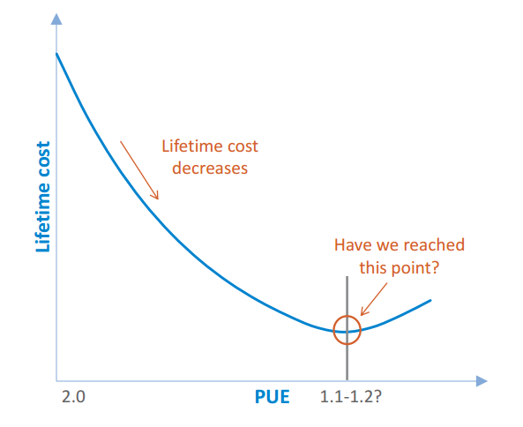
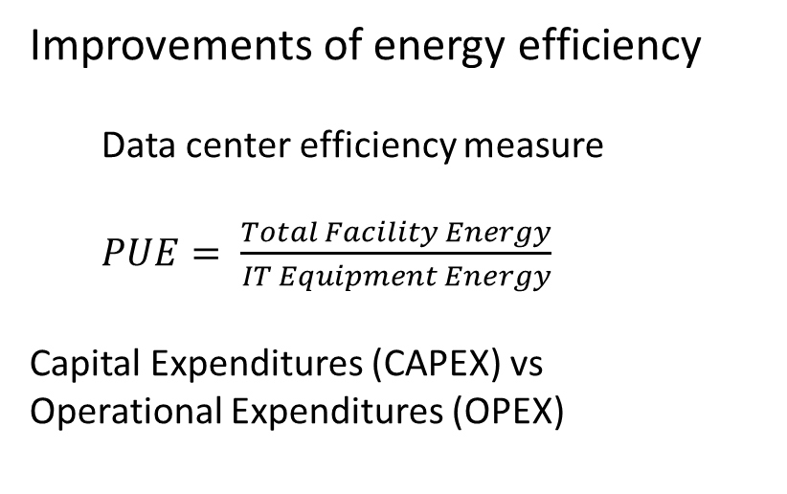
Introduction
Improvements of energy efficiency
Data center efficiency measure
$PUE= \frac{Total Facility Energy}{IT Equipment Energy}$
Capital Expenditures (CAPEX) vs
Operational Expenditures (OPEX)
Source: Data Center Trends [2]

Slide 7
Main Contributions
Framework for cost optimization in Multi Cloud Environments
Decision support for handling VM migrations
Advanced cloud scheduler for handling tradeoff between cost optimization and SLA penalties
Advanced simulation for modeling cloud conditions
Data Analysis of power market data
Forecast model selection based on data
Large scale evaluation of forecasting methods based on electricity price data from various energy markets

Slide 8
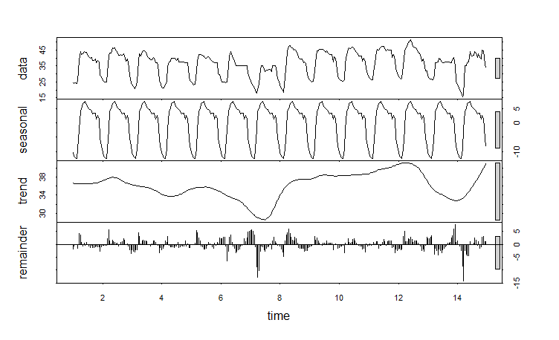
Methodological Approach
Evaluation of energy price data
Day ahead and real time price time series evaluation
Estimate seasonality by frequency analysis
Determine auto correlations in energy price data
Evaluation of energy price characteristics in different energy markets
Estimation of trend, seasonal and cycle components
Two weeks of day ahead price data, July 2014

Slide 9
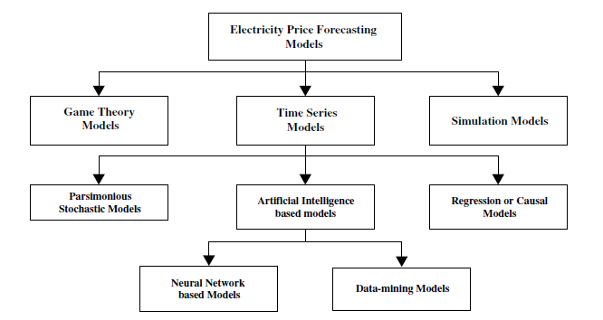
Methodological Approach
Forecast model evaluation
Forecast model classification
Analysis of statistical forecasting models
Source: Classification of price forecasting models [1]

Slide 10
Methodological Approach
Forecast model building
Definition of statistical forecasting models
SES
SES + Trend (Holt)
SES + Trend + Seasonal (HoltWinters)
ARIMA
TBATS (Multiple Seasonality)
Generate ARIMA models based on the Box-Jenkins approach
Populate general class of models (trend and seasonality)
Identify model to be evaluated (model parameters)
Estimate parameters in identified model (maximum likelihood)
Diagnosis checking (model appropriateness)
Apply model to forecasting
Forecast accuracy evaluation

Slide 11
Methodological Approach
Cloud scheduling and utility function
Define criteria values to include in utility function
Define utility function for scheduler
Simulation scenario
Set simulation parameters and boundary conditions

Slide 12
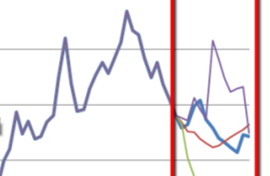
Forecasting
Goals
Build Forecast models for energy price prediction
Suitable for day ahead and real time energy prices
Automated model selection
Large scale forecast model evaluation
Selection of relevant and baseline models
Performance evaluation over extended time range

Slide 13
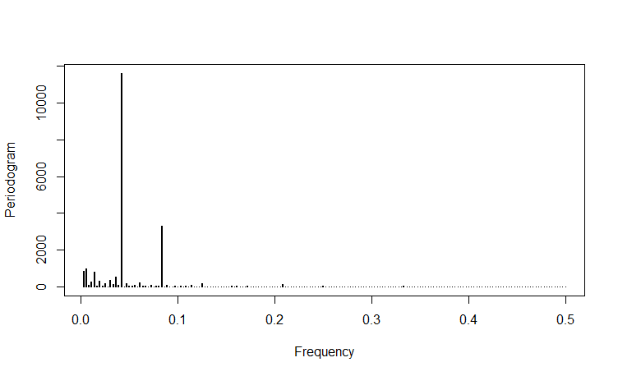
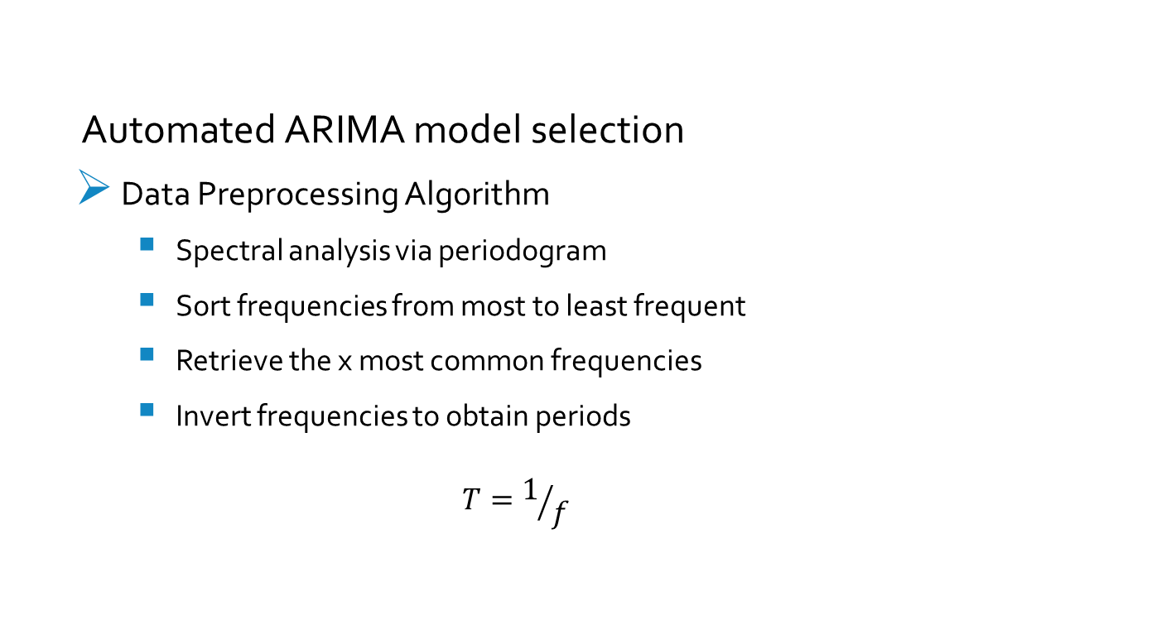
Forecasting
Automated ARIMA model selection
Data Preprocessing Algorithm
Spectral analysis via periodogram
Sort frequencies from most to least frequent
Retrieve the x most common frequencies
Invert frequencies to obtain periods
$$T=1/f$$

Slide 14
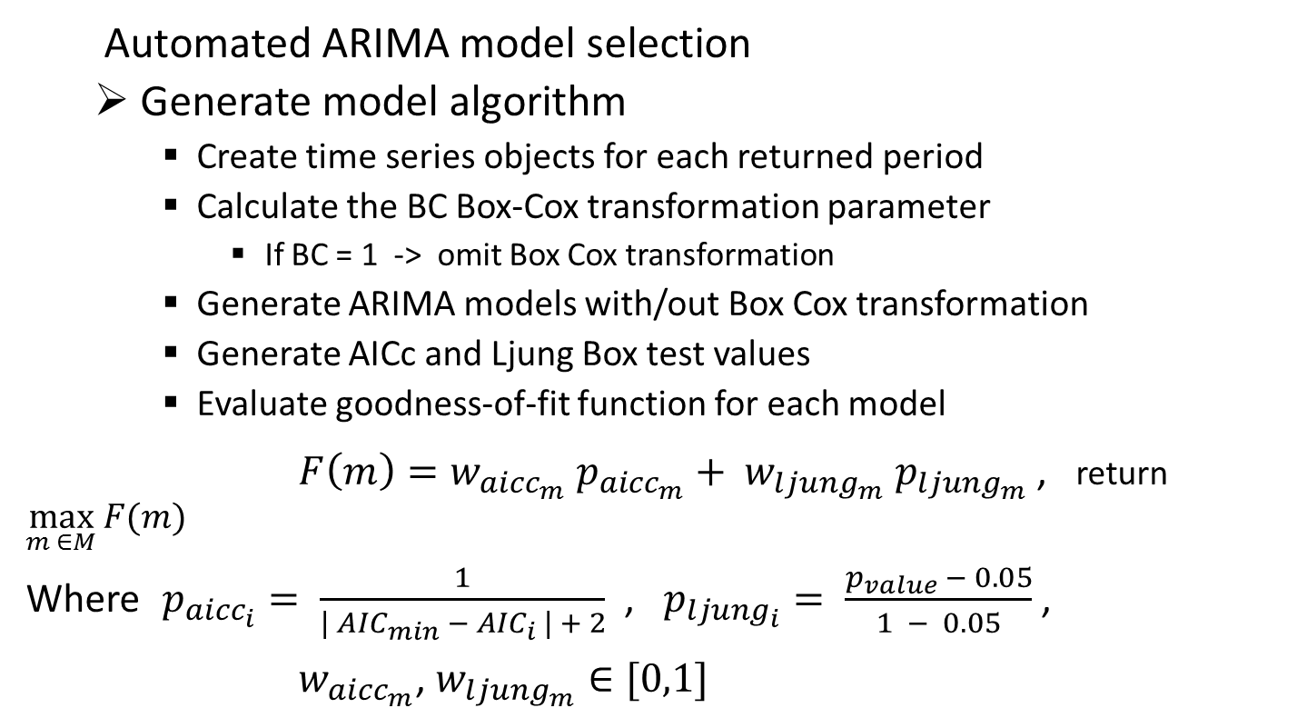
Forecasting
Automated ARIMA model selection
Generate model algorithm
Create time series objects for each returned period
Calculate the BC Box-Cox transformation parameter
If BC = 1 -> omit Box Cox transformation
Generate ARIMA models with/out Box Cox transformation
Generate AICc and Ljung Box test values
Evaluate goodness-of-fit function for each model
$F\left(m\right)=w_{{aicc}_{m}} p_{{aicc}_{m}}+ w_{{ljung}_{m}} p_{{ljung}_{m}}$ , return $\max_{m ∈M}{F(m)}$
Where $p_{{aicc}_{i}}= \frac{1}{\left| {AIC}_{min} − {AIC}_{i} \right| + 2}$ , $p_{{ljung}_{i}}= \frac{p_{value} − 0.05}{1 − 0.05}$ ,
$w_{{aicc}_{m}}$, $w_{{ljung}_{m}}∈[0,1]$
Notes:
Weighted function of AICc and Ljung Box p-values
AICc is the corrected Akaike Information Criterion as a measure of goodness of fit for ARIMA models
Ljung Box is a test for white noise property of data.
H_0 is the hypothesis that the time series is white noise (identically independently distributed iid).
H_a is the inverse assumption, i.e. that correlations exist in the data.
If the p-value falls below a threshold of 0.05 it is said that the white noise hypothesis can be rejected

Slide 15
Forecasting
Large scale forecast evaluation
Evaluation of six different forecast models
Mean, SES, Holts, Holtwinters, TBATS, ARIMA
Energy price data from 4 different energy markets (DA + RT)
Nord Pool Spot, Belpex (DA), ISO-NE, PJM (RT)
Model generation for three different trainings data periods
2 weeks, 3 weeks, 4 weeks
Forecast evaluation for ten different forecast horizons
1,3,6,12,18,24,36,48,96,168 hours
Forecast comparison by five different accuracy measures
ME, RMSE, MAE, MPE, MAPE
Evaluation over a time range of 3 years (2012 – 2014)
Intervals of 1 week

Slide 16
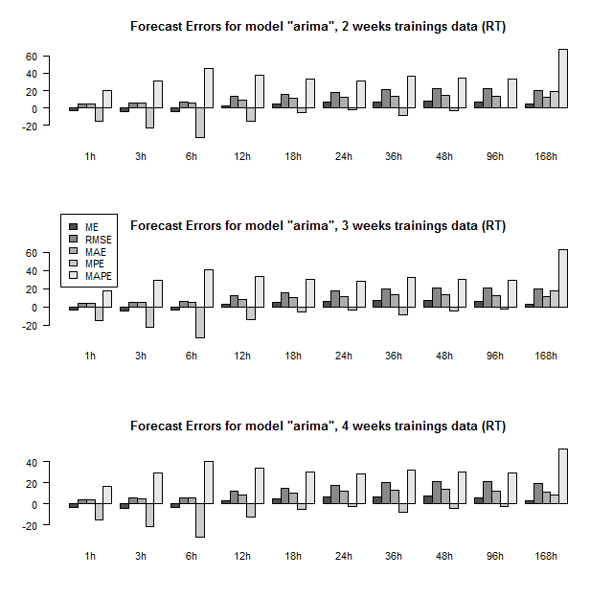
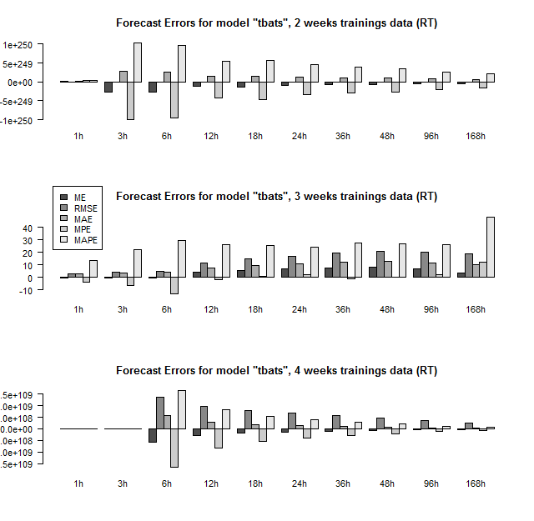
Forecasting
Large scale forecast evaluation – Results

Slide 17
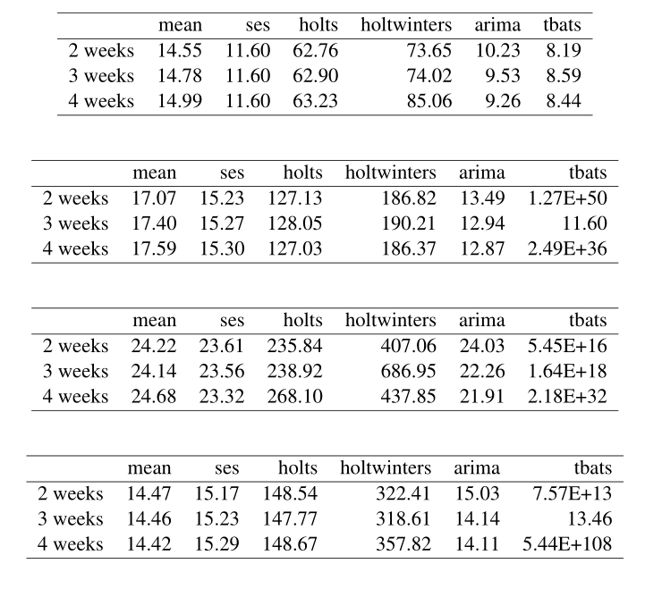
Forecasting
Large scale forecast evaluation – Results
Nord Pool (DA)
Belpex (DA)
ISO-NE (RT)
PJM (RT)
Notes:
Different results based on model and accuracy metric
RMSE, ARIMA -> 2 weeks of trainings data
Forecast horizon with minimal RMSE: 24 hours
Model with minimal RMSE: ARIMA
TODO !! Evaluate results

Slide 18
Simulation Scenario
Definition of simulation parameters
DA and RT simulations
5 weeks / 4 months in 2013
Five different energy markets
Nord Pool, Belpex, EpexSpot, ISO-NE, PJM
Bandwidth between locations
1000 Mbit/s, 800 Mbit/s, 400 Mbit/s
Cloud infrastructure
Uniform distribution of servers / VMs
200 / 100 servers per location depending on scenario
400 / 1000 / 3000 VMs per location depending on simulation time range
Notes:
Simulation Summer (hours): 24*38 = 912,
Avg duration of VMs: 8 hours
Number of time spans with different VMs on avg: 912 / 8 = 114
DA Summer: 1000 VMs / location = 5000 VMs
Number of VMs per avg duration:
DA Summer: 5000 / 114 = 43.8 ~ 44 VMs on avg at the same time
DA Summer: 1000 / 114 = 8.77 ~ 9 VMs on avg at the same time per location

Slide 19
Simulation Scenario
Definition of simulation parameters
Different types of workload
Uniform distribution over set of values
Server Cores: 4 – 8
Server Memory: 8 – 16
VM Cores: 1 – 4
VM Memory: 1 – 4 GB
VM Durations: 1 / 2 / 5 / 8 / 12 / 24 / 48 hours
VM Dirty page rates: 20 / 40 / 70 / 90 MB/s
Additional parameters
VM SLA availability level: 99.95 %
Penalty costs: 99.00% - < 99.95% -> 10% penalty refund
95.00% - < 99.00% -> 25% penalty refund
< 95.00% -> 50% penalty refund
Bandwidth costs: 0.1 c / GB
Price VM: 0.04 $ / h

Slide 20
Simulation Scenario
Cloud Scheduler
Based on utility function
Prioritizing different criteria
e.g. cost reductions vs. SLA penalties
Current and future price developments
Definition of max fc horizon up to which to consider energy prices
Seven different scenarios
Resulting power and cost evaluation

Slide 21
Simulation Scenario
Definition of Scenarios
Scenario 1: BFD baseline scheduler
Request assignment: not cost aware, based on load
Migrations: None
Scenario 2: BCU scheduler
Request assignment: cost aware, no forecasts
Migrations: None
Scenario 3: BCU scheduler + FC
Request assignment: cost aware, forecasts
Migrations: None
Scenario 4: BCU scheduler + Ideal FC
Request assignment: cost aware, ideal forecasts
Migrations: None
Scenario 5: BCU scheduler + M
Request assignment: cost aware, no forecasts
Migrations: cost aware, no forecasts
Scenario 6: BCU scheduler + M + FC
Request assignment: cost aware, forecasts
Migrations: cost aware, forecasts
Scenario 7: BCU scheduler + M + ideal FC
Request assignment: cost aware, ideal forecasts
Migrations: cost aware, ideal forecasts

Slide 22
Simulation Scenario
Utility Function
Criteria | Name | Description
c1 | probability of SLA penalty | probability that an SLA penalty will occur after migration (based on experienced downtime)
c2 | estimated migration energy | the expected migration energy depending on VM memory, bandwidth and dirty page rate
c3 | remaining VM duration | number of unit time spans the job or VM is still running
c4 | data center load | investigate current DC loads, focus on load balancing
c5 | estimated cost benefit | expected migration benefit (cost savings) given the current conditions

Slide 23
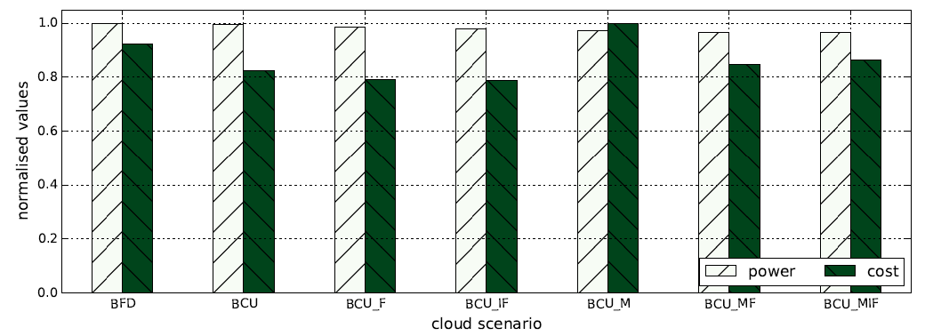
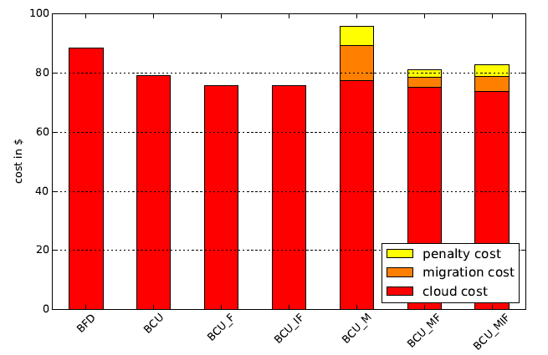
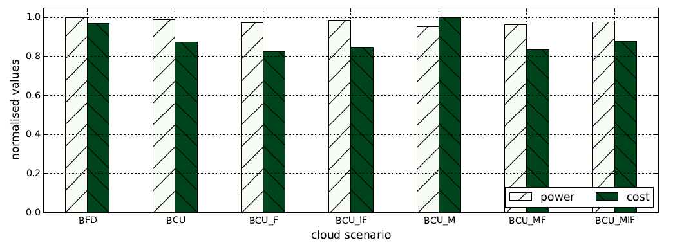
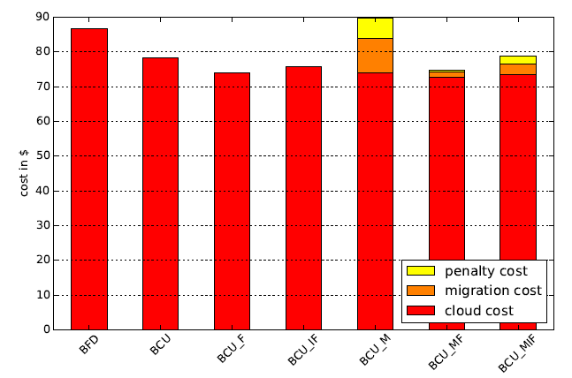
Simulation Results
Evaluate utility function – energy vs cost utility
w_sla = 0.4
w_energy = 0.7
w_vm_rem = 0.5
w_dcload = 0.4
w_cost = 0.8
TH = 1.8
w_sla = 0.3
w_energy = 0.4
w_vm_rem = 0.2
w_dcload = 0.1
w_cost = 1.0
TH = 1.4

Slide 24
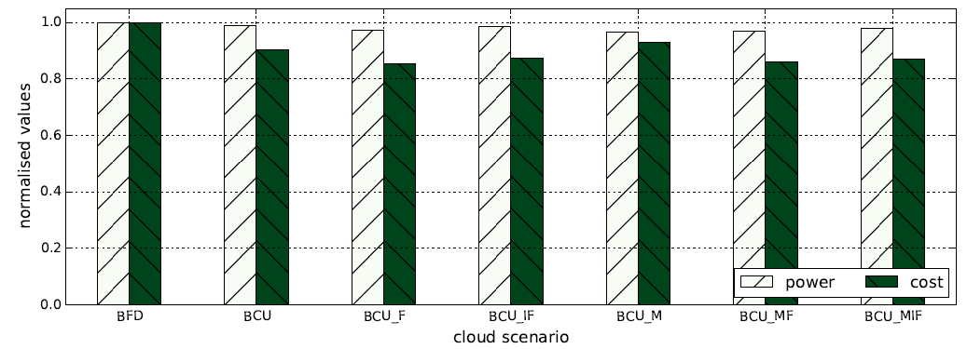
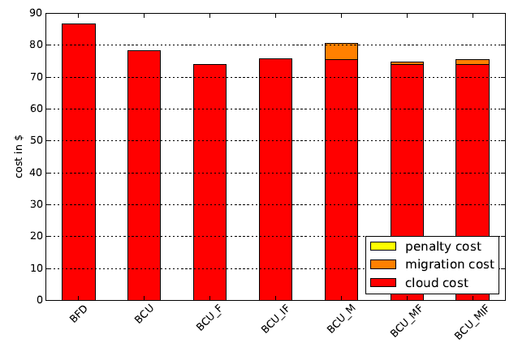
Simulation Results
Evaluate utility function – best utility
w_sla = 1.0 w_energy = 0.1 w_vm_rem = 0.2 w_dcload = 0.1 w_cost = 1.0 TH = 2.0

Slide 25
Simulation Results
Simulation Runs
Small scale DA and RT simulations (5 weeks)
Large scale DA and RT simulations (4 months)
Simulation Configuration
Cloud generation depending on scenario
Utility values taken from Best utility evaluation
Forecast models pre-generated for each day of the simulation
Bandwidth mapping, VM price, bandwidth cost, max fc horizon fixed
Evaluation of cloud scenarios and metrics

Slide 26
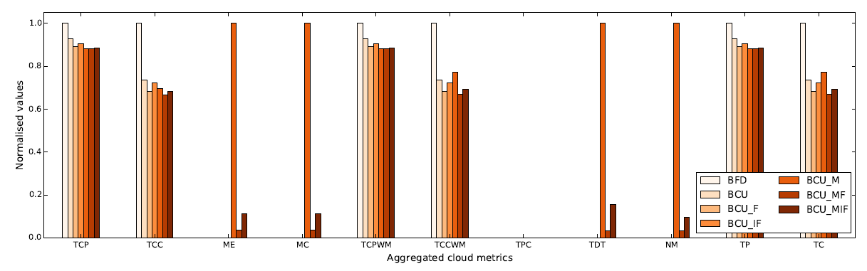
Simulation Results
Simulation „RT Spring“ (4 months 2013)

Slide 27
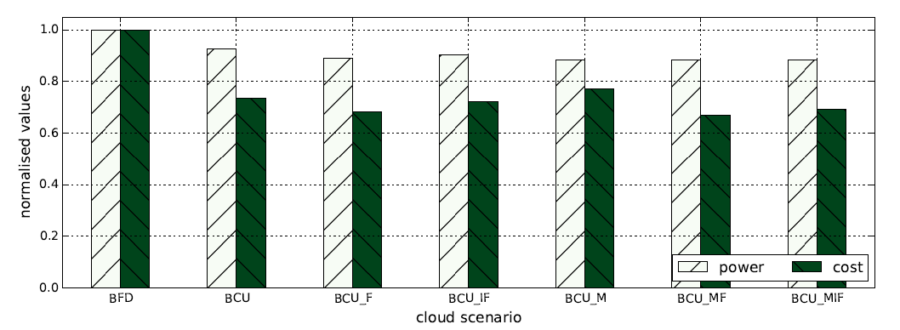
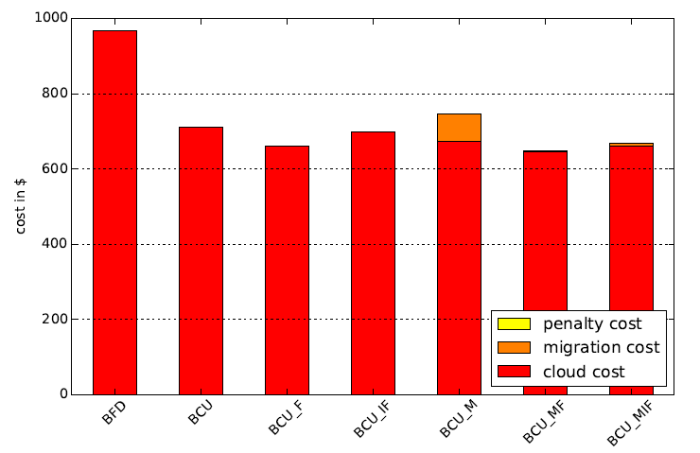
Simulation Results
Simulation „RT Spring“ (4 months 2013)

Slide 28
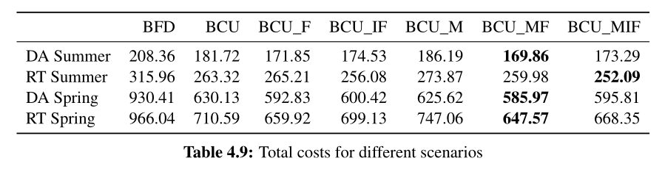
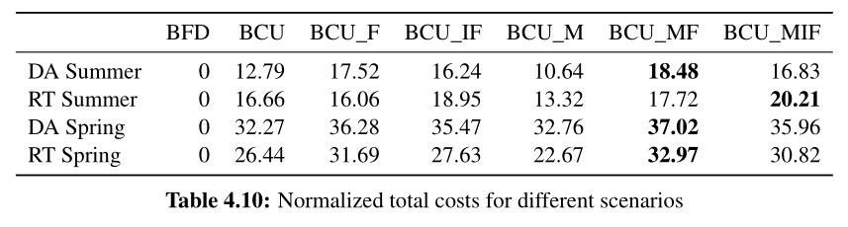
Simulation Results
Aggregated data for all simulations

Slide 29
Conclusion
Results
Significant cost savings for data centers connected to power markets
Promising results for both day ahead and real time markets
Good performance of selected forecast models
Best results for long term simulations
Future Outlook
Selection of additional energy markets and / or time ranges
Include temperature data and cooling costs
Optimize utility function by automatic parameter selection
Definition of additional utility criteria
Evaluation for different bandwidth / dirty page rate combinations
Adjustments of fixed parameters (vm price, bandwidth costs)

Slide 30
Conclusion
Bibliography
[1] Google Data Center Efficiency: Measuring Power Usage Effectiveness http://www.google.com/about/datacenters/efficiency/internal/#measuring-efficiency
[2] Data Center World. Data center trends: Optimizing power markets. http://www.datacenterworld.com/fall2013/account/Uploader/uploader_files/show/335/, 2013. Online;accessed 28-February-2016.

Slide 31
Thank You for Your Attention

